Slide 1
14 Complex Integration

Slide 2
14.1 Line Integral in the Complex Plane

Slide 3
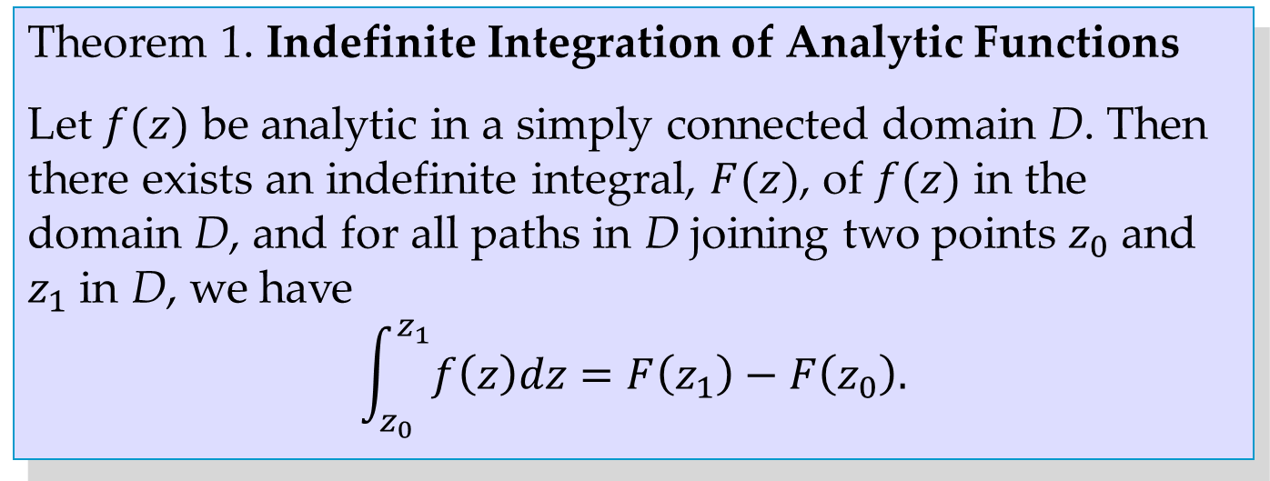
Theorem 1. Indefinite Integration of Analytic Functions
Let $f(z)$ be analytic in a simply connected domain D. Then there exists an indefinite integral, $F(z)$, of $f(z)$ in the domain D, and for all paths in D joining two points $z_{0}$ and $z_{1}$ in D, we have
$$\int_{z_{0}}^{z_{1}}{f\left(z\right)dz=F\left(z_{1}\right)−F\left(z_{0}\right).}$$

Slide 4
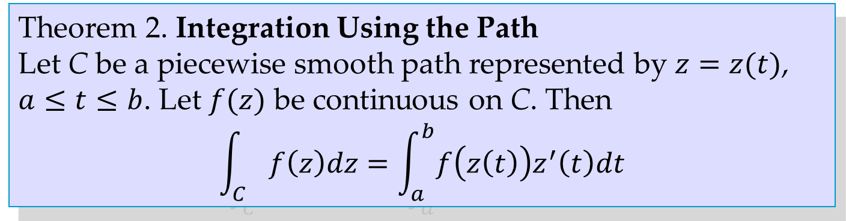
Theorem 2. Integration Using the Path
Let C be a piecewise smooth path represented by $z=z(t)$, $a≤t≤b$. Let $f(z)$ be continuous on C. Then
$$\int_{C}{f\left(z\right)dz=\int_{a}^{b}{f\left(z\left(t\right)\right)z^{′}\left(t\right)dt}}$$

Slide 5
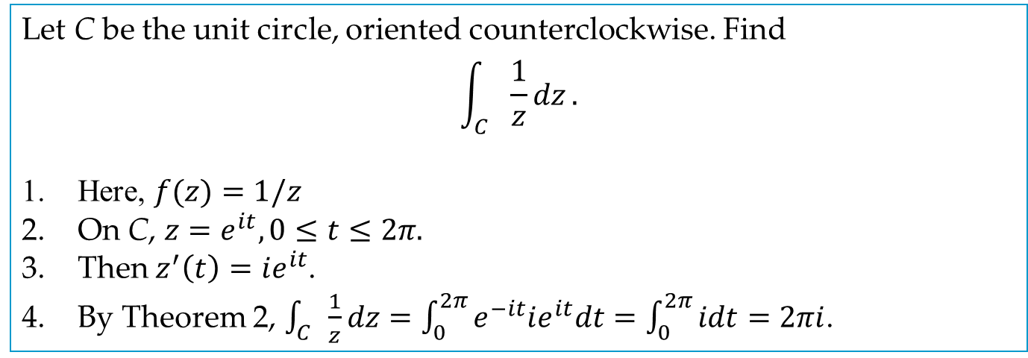
EXAMPLE 2
Let C be the unit circle, oriented counterclockwise. Find
$$\int_{C}{\frac{1}{z}dz}.$$
Here, $f(z)=1/z$
On C, $z=e^{it}, 0≤t≤2π.$
Then $z^{′}\left(t\right)=ie^{it}$.
By Theorem 2, $\int_{C}{\frac{1}{z}dz=\int_{0}^{2π}{e^{−it}ie^{it}dt=\int_{0}^{2π}{idt=2πi}}}$.

Slide 6
14.2 Cauchy’s Integral Theorem

Slide 7
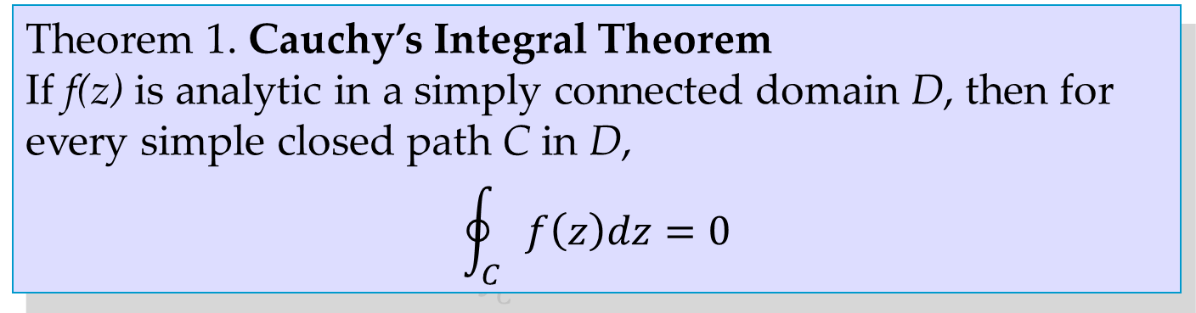
Theorem 1. Cauchy’s Integral Theorem
If f(z) is analytic in a simply connected domain D, then for every simple closed path C in D,
$$\oint_{C}{f\left(z\right)dz=0}$$

Slide 8
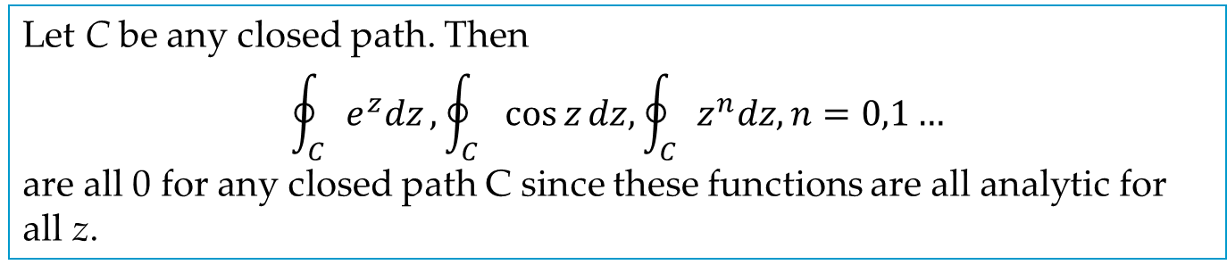
EXAMPLE 1
Let C be any closed path. Then
$$\oint_{C}{e^{z}dz},\oint_{C}{\cos{z}dz,\oint_{C}{z^{n}dz, n=0,1…}}$$
are all 0 for any closed path C since these functions are all analytic for all z.

Slide 9
14.3 Cauchy’s Integral Formula

Slide 10
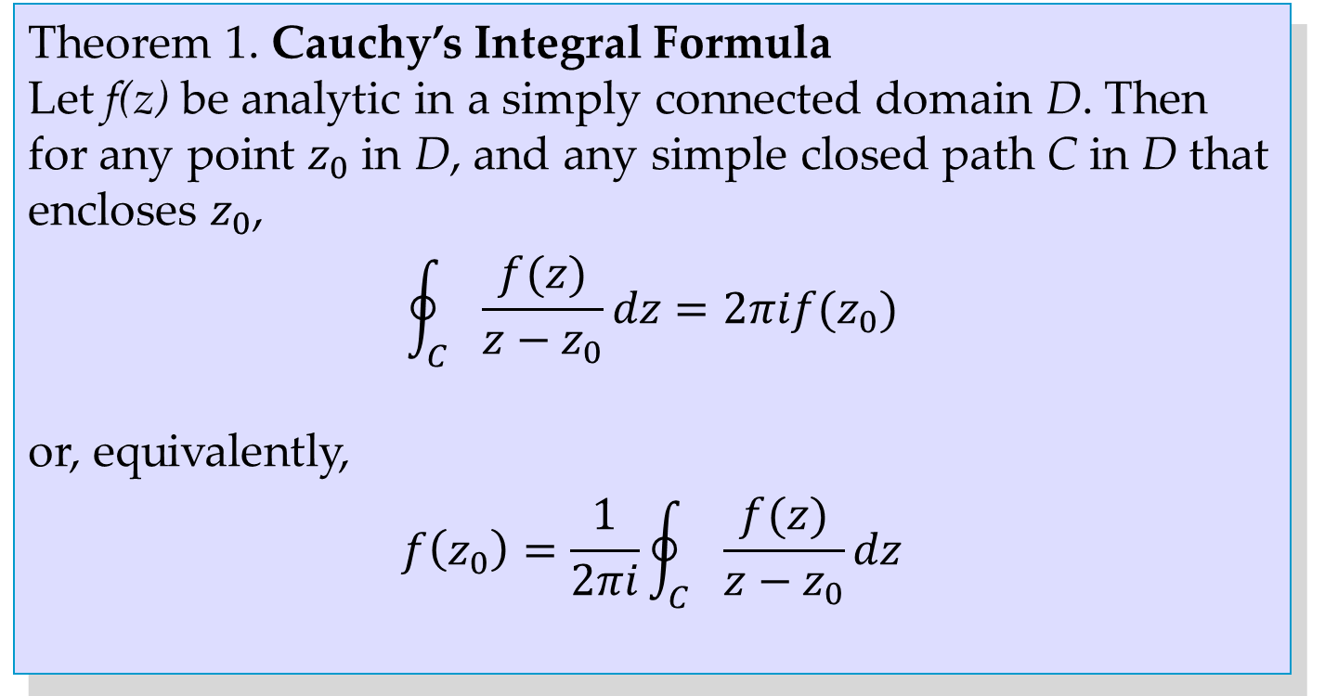
Theorem 1. Cauchy’s Integral Formula
Let f(z) be analytic in a simply connected domain D. Then for any point $z_{0}$ in D, and any simple closed path C in D that encloses $z_{0}$,
$$\oint_{C}{\frac{f(z)}{z−z_{0}}dz=2πif(z_{0})}$$
or, equivalently,
$$f\left(z_{0}\right)=\frac{1}{2πi}\oint_{C}{\frac{f(z)}{z−z_{0}}dz}$$

Slide 11
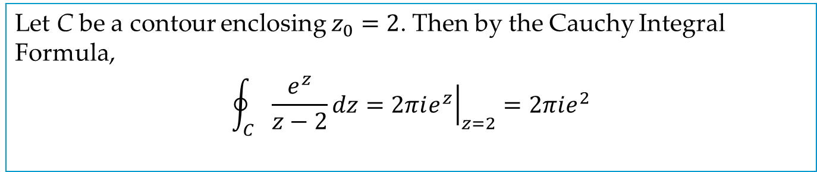
EXAMPLE 1
Let C be a contour enclosing $z_{0}=2$. Then by the Cauchy Integral Formula,
$$\oint_{C}{\frac{e^{z}}{z−2}dz={\left.2πie^{z}\right|}_{z=2}=2πie^{2}}$$

Slide 12
Theorem 2. Independence of Path
If f(z) is analytic in a simply connected domain D, then the integral of f(z) is independent of the path in D.

Slide 13
14.4 Derivatives of Analytic Functions

Slide 14
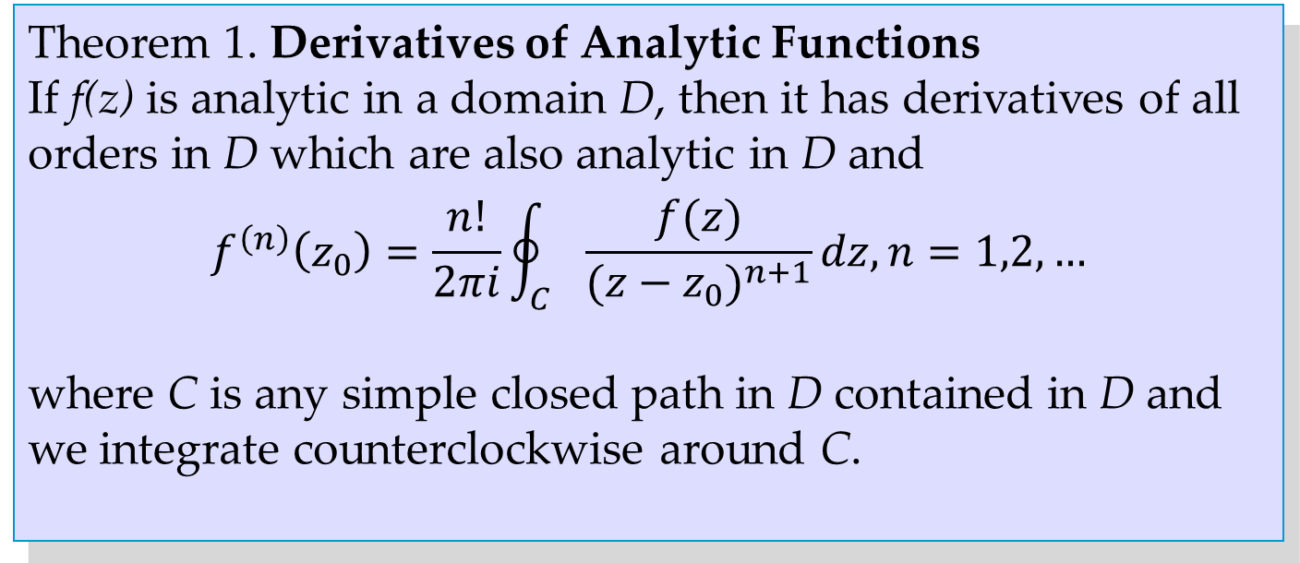
Theorem 1. Derivatives of Analytic Functions
If f(z) is analytic in a domain D, then it has derivatives of all orders in D which are also analytic in D and
$$f^{\left(n\right)}\left(z_{0}\right)=\frac{n!}{2πi}\oint_{C}{\frac{f(z)}{{(z−z_{0})}^{n+1}}dz, n=1,2,…}$$
where C is any simple closed path in D contained in D and we integrate counterclockwise around C.

Slide 15
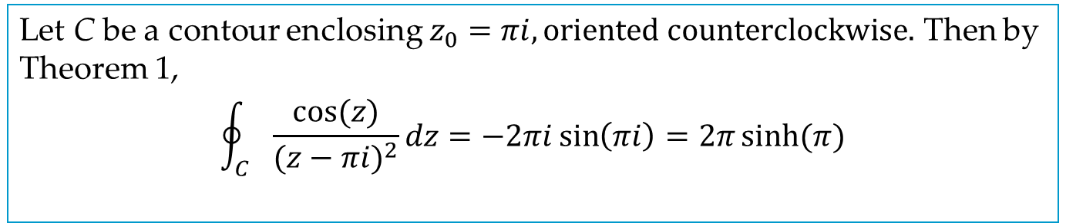
EXAMPLE 1
Let C be a contour enclosing $z_{0}=πi, oriented counterclockwise.$ Then by Theorem 1,
$$\oint_{C}{\frac{cos⁡(z)}{{(z−πi)}^{2}}dz=−2πi\sin\left(πi\right)=2π\sinh{(π)}}$$

Slide 16
Theorem 2. Liouville’s Theorem
If an entire function is bounded in absolute value in all of the complex plane, then this function must be a constant.

Slide 17
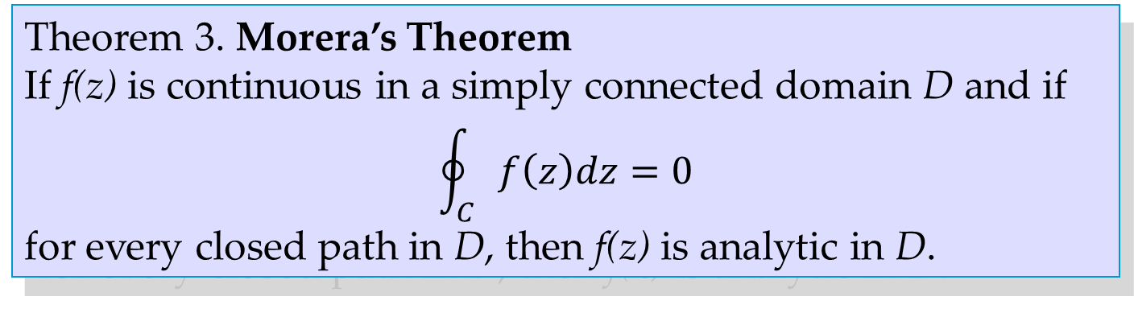
Theorem 3. Morera’s Theorem
If f(z) is continuous in a simply connected domain D and if
$$\oint_{C}{f\left(z\right)dz=0}$$
for every closed path in D, then f(z) is analytic in D.

